Slide 1
Reel Review
Movie Recommender
Leonardo Lopez
Nuha Aldausari
Michael Guynn

Slide 2
Workload between members
Leonardo Lopez: Everything
Nuha Aldausari:
Michael Guynn:

Slide 3
Workload between members
Leonardo Lopez: Schema Design, DB Creation Parser, Tags UI, Queries
Nuha Aldausari: UI Design, Initial Query Design, Recommendation
Michael Guynn: UI Design, Queries, Bug Fixing, Random enhancements

Slide 4
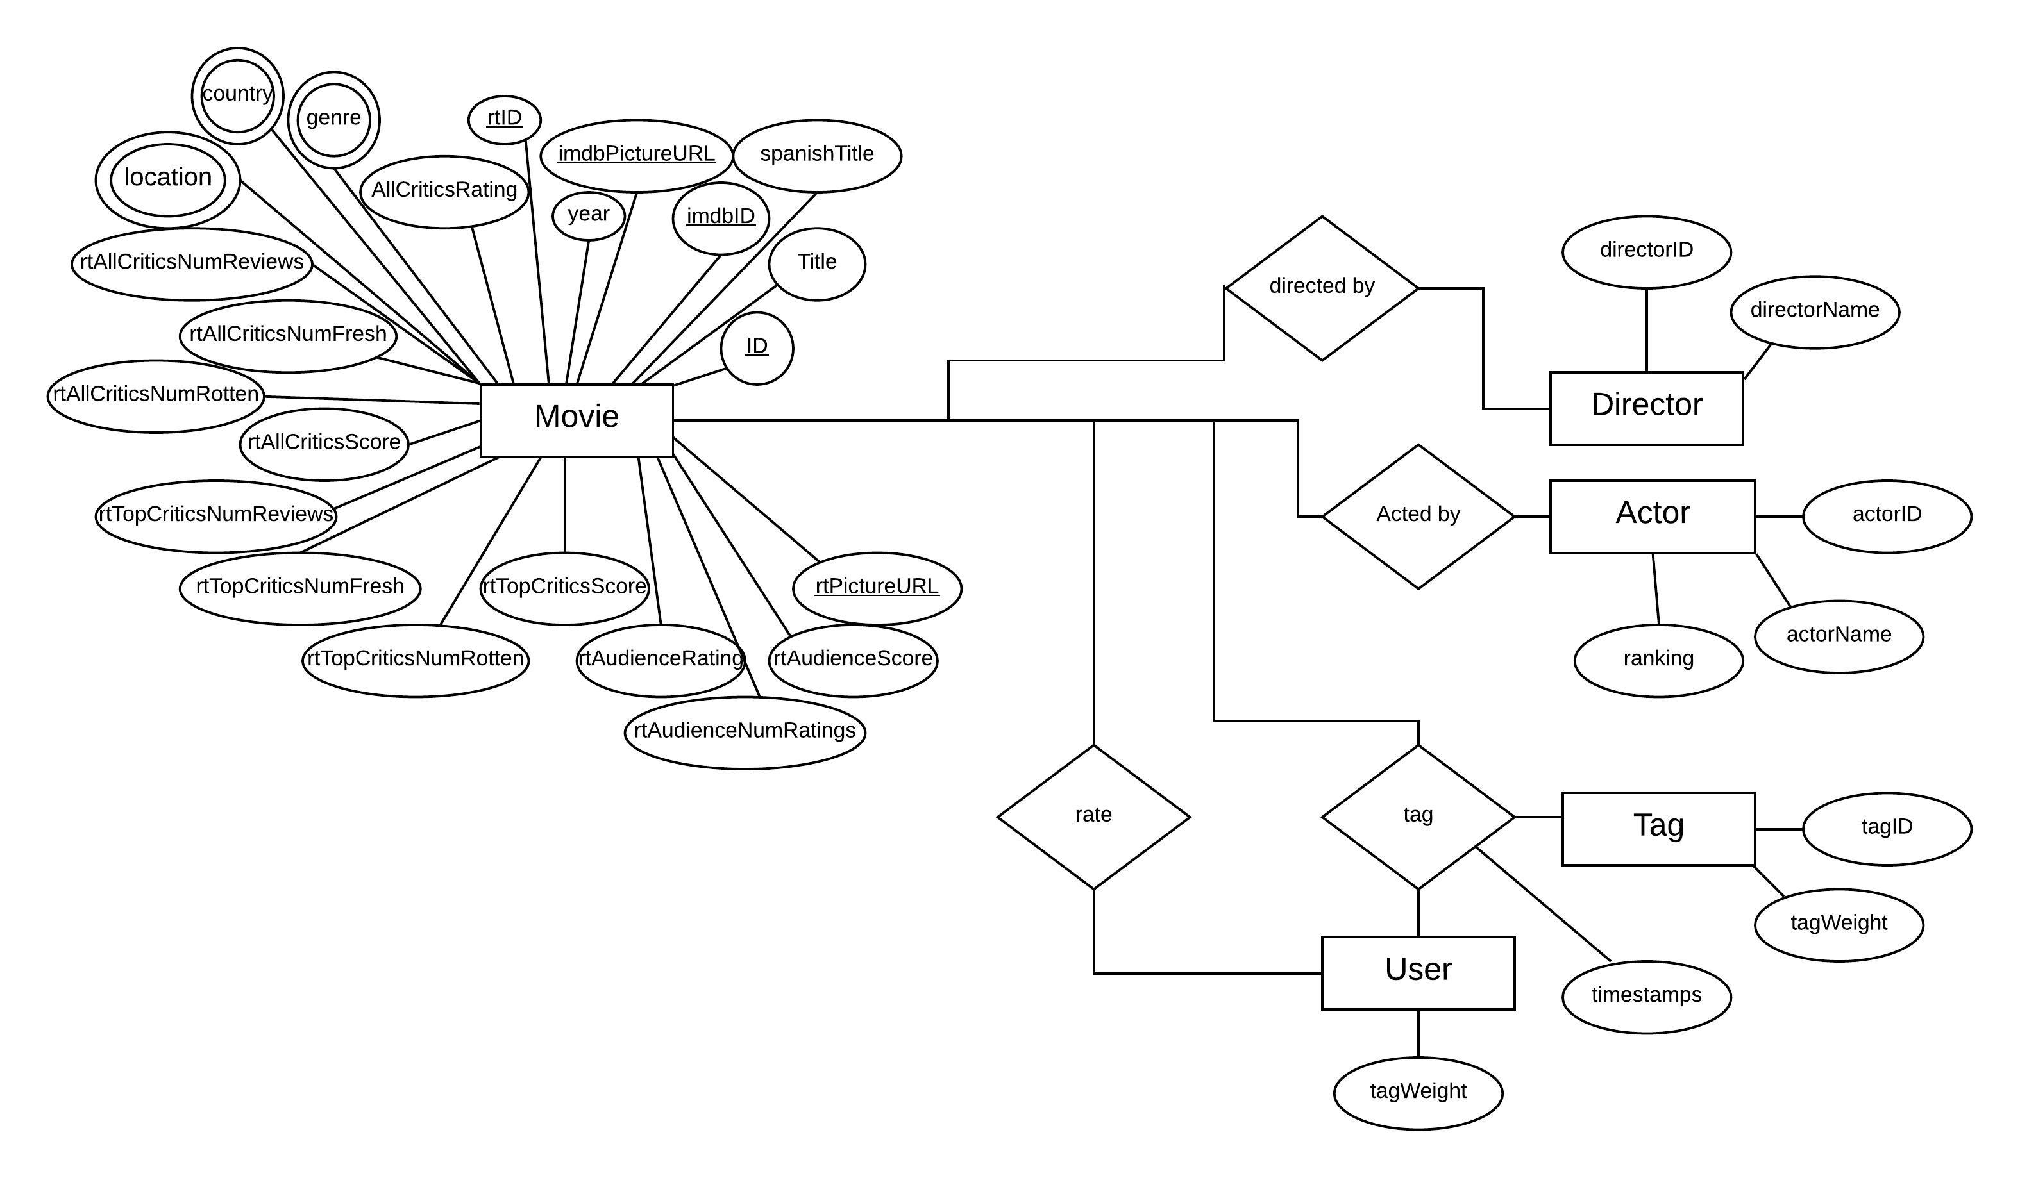
App Entity Relationship (ER) Diagram

Slide 5
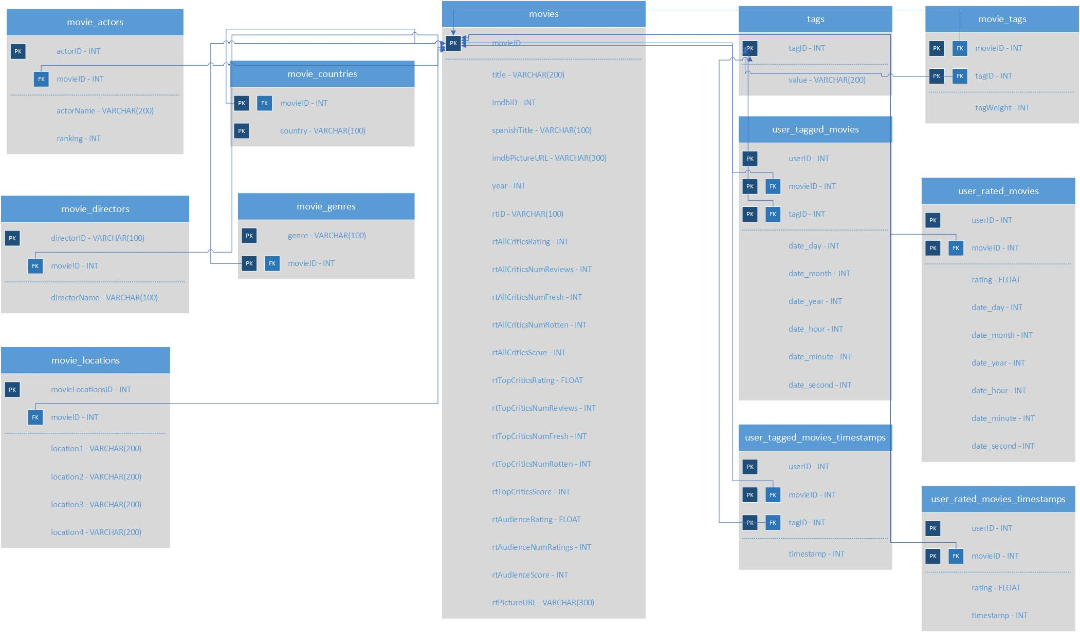
App Database Schema Diagram

Slide 6
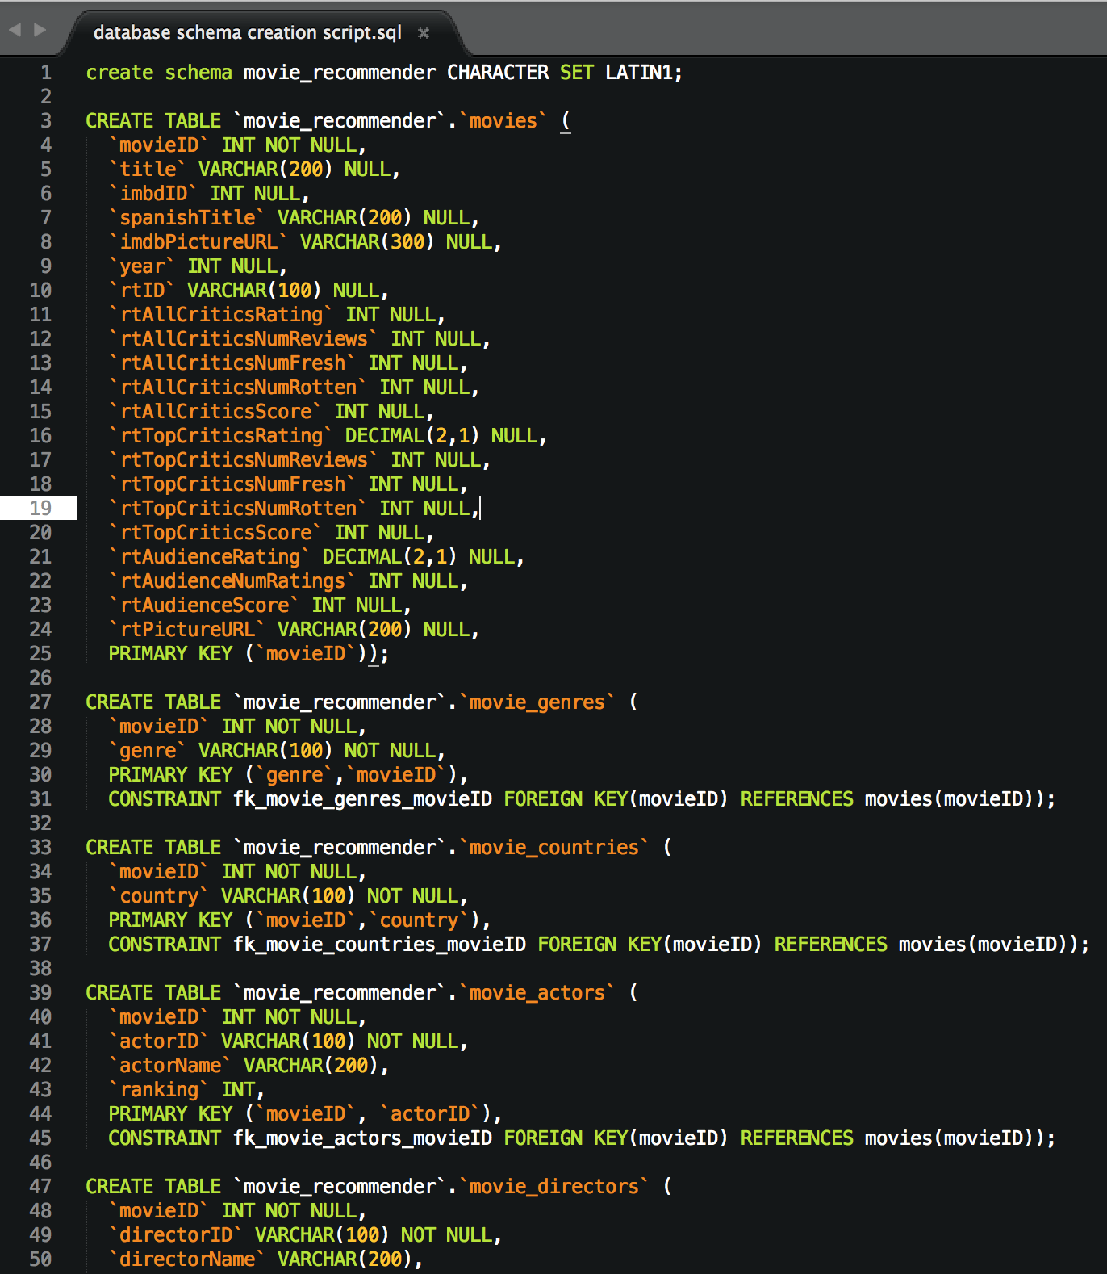
SQL Scripts

Slide 7
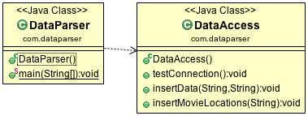
Parser Class Diagram

Slide 8
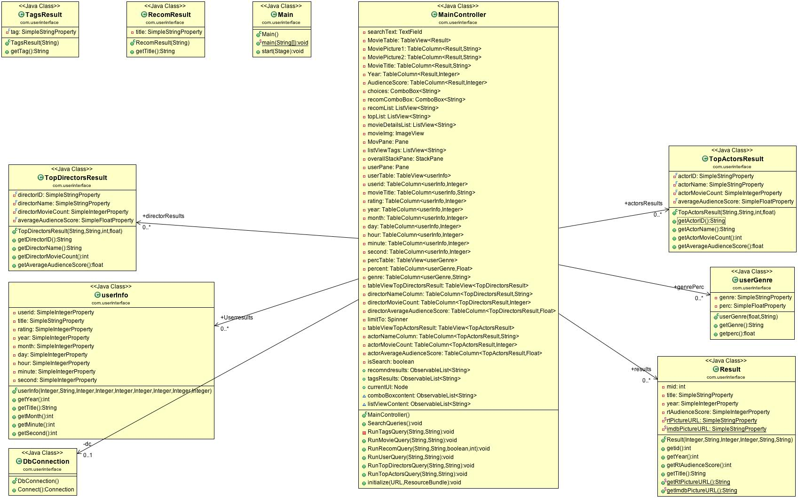
High Level Code Design (App Class Diagram)

Slide 9
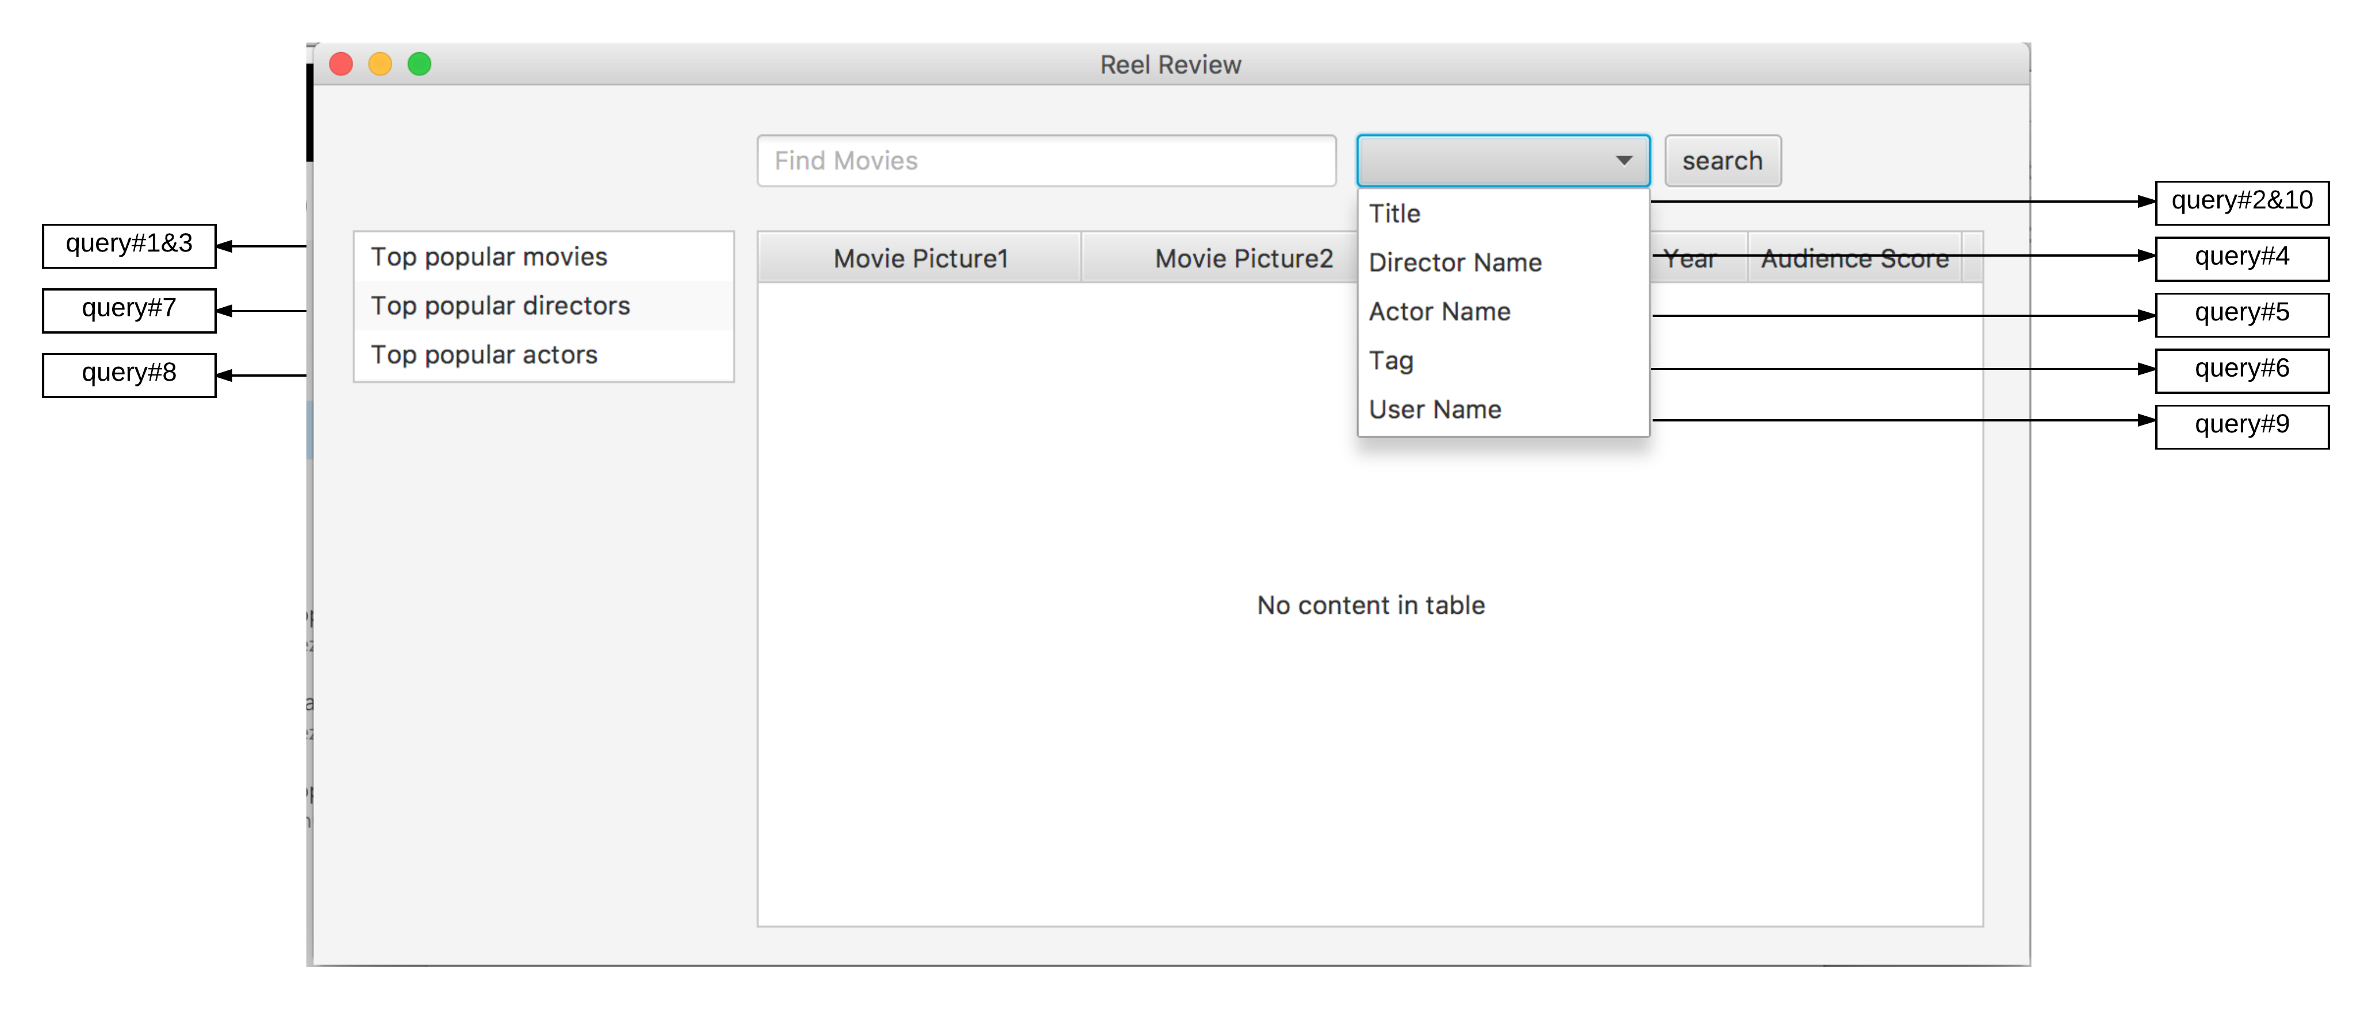
Query to User Interface Diagram (System Functionality)

Slide 10
Here’s the demo…

